Slide 1

The Strategic Plan, The Annual Work Programme and Budget

Slide 2

Cycle of preparation of the Strategic Plan and the annual work programme and budget and the role of Member States
Member States Induction Seminar

Slide 3

Key programme planning documents: Strategic Plan 2020-2023
UN-Habitat Strategic Plan 2020-2023:
Vision “a better quality of life for all in an urbanizing world”.
This vision is encapsulated in the Plan’s 4 domains of change:
Reduced spatial inequality and poverty in communities across the urban - rural continuum;
Enhanced shared prosperity of cities and regions;
Strengthened climate action and improved urban environment;
Effective urban crisis prevention and response.
Approved by the first UN-Habitat Assembly
The Strategic Plan is developed :
Based on UN-Habitat’s mandate;
Using empirical data gathered from research to identify emerging issues;
With the inputs of Member States though the Governing Bodies and the demand at country level;
Using information from the sessions of the World Urban Forum emanating from governments and partners.
Extension till 2025 to be considered and validated by the second UN-Habitat Assembly, following positive review by the CPR in its mid-term review and the Executive Board
Defines UN-Habitat’s medium- to long-term goals, as well as the resources plans to achieve them
And strongly contributes to the implementation and monitoring of the SDGs and the New Urban Agenda.

Slide 4

Key programme planning documents: Annual Work Programme and Budget
  Annual UN-Habitat Work Programme & Budget:
  summarizes UN-Habitat’s objectives and priority areas for a given year
  contains a detailed list of the evaluation activities that the UN-Habitat will undertake
  defines the human and financial resources required to implement the annual work programme.
This document sets out the proposed annual work programme and budget of UN-Habitat which is based on strategic plan for the period 2020–2025

Slide 5
How are mandates translated into programme planning documents?
UN-Habitat´s Mandate: Entrusted with supporting Member States and other key stakeholders in addressing the many challenges of sustainable urbanization.
Robust and clear strategic focus to guide UN-Habitat’s work.
Result of a large internal and external consultative and participatory process, culminating in the adoption by the UN-Habitat Assembly.
Strategic Plan
Rule 2 (f) of the rules of procedure of the UN-Habitat Assembly gives the UN-Habitat Assembly the mandate to examine and approve the Strategic Plan, to be prepared by the Executive Board. The Committee of Permanent Representatives proceeds to the Mid-term review of the implementation of UN-Habitat Strategic Plan.
Proposed annual work programme of UN-Habitat, based on the Strategic Plan. Designed to drive and focus the UN-Habitat approach to and delivery of more inclusive and integrated human settlements.
Annual
Programme
of work
Rule 5 (c) of the rules of procedure of the Executive Board gives the mandate to the Executive Board to approve and oversee
the implementation of the annual programme of work.
Finances the backbone and essential ability of the UN-Habitat Secretariat to carry out its core functions and implement its Strategic Plan through its programme of work.
Annual Budget
Rule 5 (c) of the rules of procedure of the Executive Bord gives the mandate to the Executive Board to approve and oversee the implementation of the annual budget.

Slide 6

Discussions on the annual draft Work Programme and Budget
and
Ad-Hoc working group on programmatic, budgetary and administrative matters :
  In Decision 2020/6 adopted by the Executive Board at its second session of the year 2020, the Executive Board :
      Recognized the need to align the sessions of the Executive Board with the preparatory and approval process of the draft work programme and budget of UN-Habitat
      Empowered the Ad-Hoc working group on programmatic, budgetary and administrative matters of the Executive Board to discuss a draft work programme and budget of UN-Habitat in preparation for submission to New York (CPC / ACABQ) followed by a consideration for approval by the Executive Board.

Slide 7
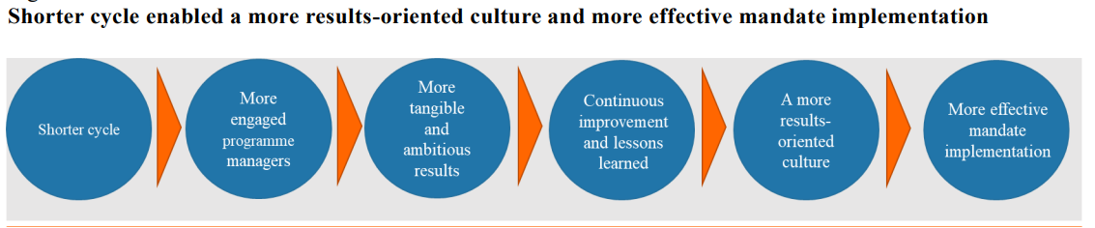
Since the first annual programme budget cycle, and with the submission of the 2023 proposed programme budget, the following achievements of the reform have materialized:
A more results-oriented culture: increased engagement by programme managers and continuous learning and improvement for more effective mandate implementation;
More agile programme planning: faster adjustment to new mandates, changed demands and conditions and past performance;
A presentation format of the annual programme budget that balances the need for more transparency and accountability demanded by Member States with a preparation process that is efficient and that allows for alignment with the operational realities of departments;
Increased comprehensiveness for a single holistic review by Member States: programme plans, performance and resource requirements integrated into one report and considered in one main session of the General Assembly.

Slide 8
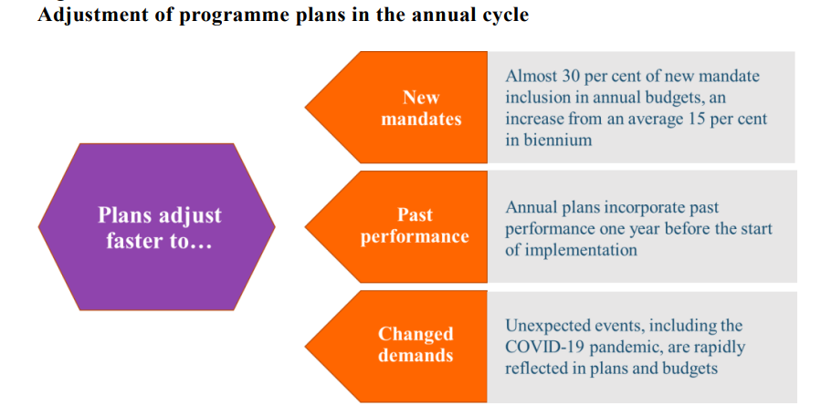
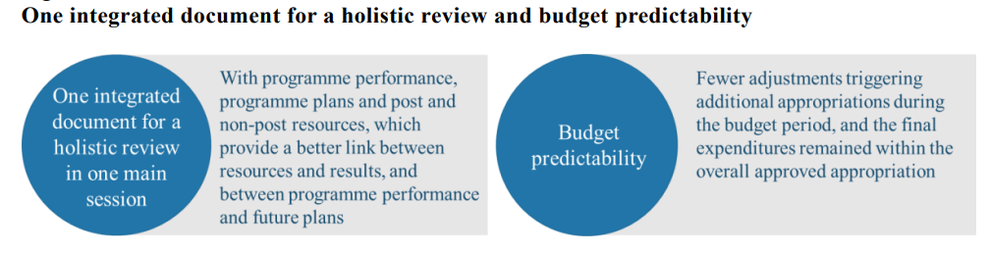

Slide 9
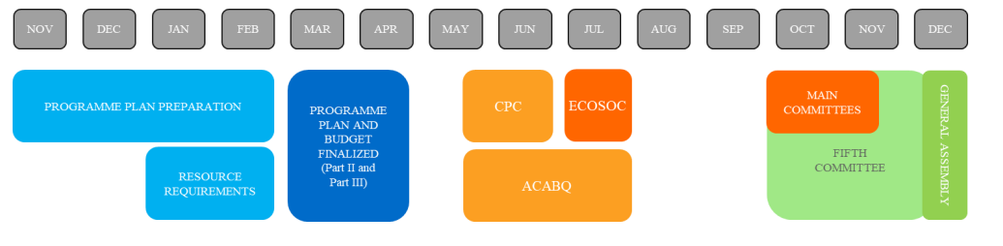
Annual Programme Planning and Budgeting Process
Ad-Hoc Working Group on programmatic, budgetary and administrative matters
Ad-Hoc Working Group on programmatic, budgetary and administrative matters
Nairobi
Executive Board
Executive Board
New York
Source: SG report on review of changes to the budgetary cycle (A/77/485)
Notes:
Annualised in 2019
Plans derived from goals and resolutions of intergovernmental organs including GA, SC, ECOSOC, HRC

Slide 10

Intergovernmental review process
Committee for Programme and Coordination
  Examines the totality of the SG's work programme
  Assesses programme results, validity against legislation, mandate coordination
Advisory Committee on Administrative and Budgetary Questions
  Examines the totality of the SG’s budget and audit reports
  Assesses budget performance, relationship to work programme, administrative matters
Sequential nature of the review processes
Notes:
Subsidiary organs of the GA
Advisory bodies

Slide 11
What does the UN Charter say about Budgeting and Financing?
Article 17
The General Assembly shall consider and approve the budget of the Organization.
The expenses of the Organization shall be borne by the Members as apportioned by the General Assembly.
The General Assembly shall consider and approve any financial and budgetary arrangements with specialized agencies referred to in Article 57 and shall examine the administrative budgets of such specialized agencies with a view to making recommendations to the agencies concerned.

Slide 12
What UN General Assembly bodies has responsibilities for budget and finance?
GENERAL ASSEMBLY (GA) has a dual function:
it provides a deliberative forum for Member States to discuss the work of the Organization and oversees the work of the Secretariat.
Comprising all 193 Member States, it provides a unique forum for multilateral discussions of the full spectrum of international issues covered by the Charter.
Primary Functions of the GA (inter-alia):
…
Maintains the authority to approve budgets, playing a critical role in ensuring that resources are available for the implementation of mandates
Broad supervision of the work of the Secretariat, especially in terms of budget, staff regulations, and the appointment of senior staff
https://www.un.org/en/auditors/board

Slide 13
The FIFTH COMMITTEE of the GA has responsibilities for administrative and budgetary matters:
Based on the reports of the Fifth Committee, the GA considers and approves the budget of the Organization in accordance with Chapter IV, Article 17 of the Charter of the United Nations.
GA also considers and approves financial and budgetary arrangements with Specialized Agencies and makes recommendations to the Agencies concerned.
The Fifth Committee may also consider urgent matters relating to the financing of a peacekeeping mission authorized by the Security Council at any of its sessions

Slide 14
The Advisory Committee on Administrative and Budgetary Questions (ACABQ), a subsidiary organ of the GA, assists the Fifth Committee.
Rule 157 of the Rules of Procedure of the GA explains: "The Advisory Committee on Administrative and Budgetary Questions shall be responsible for expert examination of the programme budget of the United Nations and shall assist the Administrative and Budgetary Committee (Fifth Committee)".
As an advisory body, reports from ACABQ include observations, conclusions and recommendations to the Fifth Committee on the proposals of the Secretary-General.

Slide 15
What is the Regular Budget (or “Programme Budget)?
Regular Budget covers the mandated activities of the UN Secretariat at Headquarters and at the Offices Away from Headquarters (OAHs), Duty Stations, Regional Commissions, special political missions, and various information centres.
Note: The regular budget also provides for two longstanding peacekeeping operations: the UN Truce Supervisory Organization (UNTSO) and the UN Military Observer Group in India and Pakistan (UNMOGIP).
Voluntary contributions and complement assessed contributions are the sole source of funding for UN Funds and Programmes.
UN Agencies, however, are financed by a mix of assessed and voluntary contributions.
Some UN Secretariat entities, such as the UN Environment Programme (UNEP), the Office on Drugs and Crime (UNODC), and the UN Human Settlements Programme (UNHABITAT rely to a large extent on extra-budgetary funding, but also have a smaller assessed budgetary component.

Slide 16
Programme budget - Authority and responsibility
Regulation 2.1. The proposed programme budget for each budget period shall be prepared by the Secretary-General.
Rule 102.1
(a) The Secretary-General shall decide on the programme content and resource allocation of the proposed programme budget to be submitted to the General Assembly.
(b) Heads of department shall prepare programme budget proposals for the forthcoming budget period at such times and in such detail as the Under-Secretary-General for Management may prescribe and in accordance with the Financial Regulations and Rules and the Regulations and Rules Governing Programme Planning, the Programme Aspects of the Budget, the Monitoring of Implementation and the Methods of Evaluation.

Slide 17
What is the UN-Habitat Foundation Fund?
Rule 302.1
The Executive Director shall prepare a proposed programme budget for the Foundation and its other extrabudgetary resources.
It shall cover all anticipated programmes of activities, including reimbursable seeding operations of the Foundation, pursuant to UNHHSF regulation 1.1, programme support costs of the Foundation and other extrabudgetary resources. The budget period and format shall be consistent with relevant United Nations budgetary regulations, rules, policies and practices. The programme budget shall include provision for contingencies;
The resources of the Foundation and other extrabudgetary funds, after providing for the programme support costs and a General Financial Reserve, shall be utilized to the maximum extent possible for programme purposes;
…

Slide 18
Thank you!
www.unhabitat.org

